Slide 1
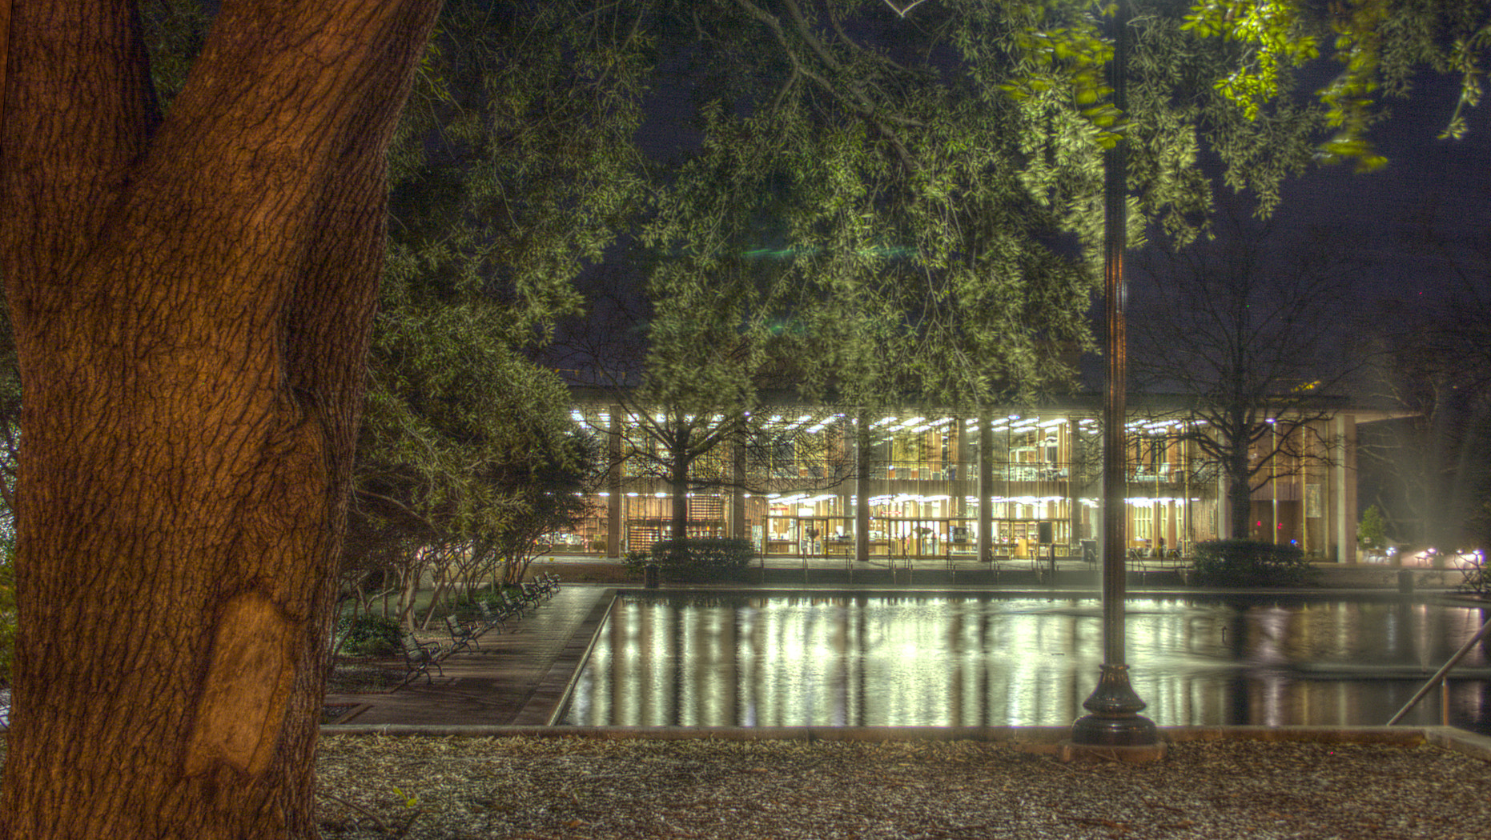
USC Libraries services and spaces
USC Faculty Senate
March 4, 2026

Slide 2

Locations
Thomas Cooper Library
Hollings Library
South Caroliniana Library
Music Library
Moving Image Research Collection (MIRC)
Library Annex
1430 Senate St.

Slide 3
Did you know?
We have nearly 1M volumes on site in TCL and nearly 1.1M items in our off-site storage facility (almost 4M total).
We have over 850,000 visitors per year in Thomas Cooper alone.
We have over 1M e-books in our collection.
We lent nearly 6,000 tech devices in AY25.
We offered 733 instruction sessions, reaching over 16,000 students, in AY25.
Our agreements with major publishers saved USC over $1M in APCs for Open Access article publications.

Slide 4
Noteworthy new resources
The Economist (along with NYT and WSJ)
Scopus
The Foundation Directory (assisted by Provost)
Open Access and Open Educational Resources (database)

Slide 5
Research and Instruction
Course instruction
Workshops
Individual consultations: for you and for your students
Ask a Librarian (chat—real people, not AI bots)

Slide 6
Distinctive collections
South Caroliniana (including political collections in Hollings)
Irvin Department (Hollings Library)
MIRC
Regular exhibits and programming (readings, lectures, performances)
Expert instruction

Slide 7
Data Services
Institutional repository (Scholar Commons): deposit your papers; ETD; digital collections
Research data management
AI and data science consulting
Research impact consulting
Statistics help, data visualization, and more

Slide 8
Partnerships
Open Carolina/USC Press
Center for Civil Rights History and Research
Office of Research
Student Success
CTE
First-gen center

Slide 9
Programs and awards
SHARPGrads
Undergraduate research awards
SCOER (Open Educational Resources) faculty awards
Data visualization awards

Slide 10

Links
Library Website:
https://sc.edu/library
Databases:
https://guides.library.sc.edu/az.php
Data services:
https://sc.edu/about/offices_and_divisions/university_libraries/get_research_help/data_services/
Data visualization awards:
https://www.sc.edu/about/offices_and_divisions/university_libraries/exhibits_events_news/news/2026/2026_data_viz_awards.php
Digital collections:
https://sc.edu/about/offices_and_divisions/university_libraries/browse/digital_collections/index.php
Distinctive collections:
https://sc.edu/about/offices_and_divisions/university_libraries/browse/index.php

Slide 11
Links
Find a librarian for your area:
https://sc.edu/about/offices_and_divisions/university_libraries/find_services/faculty_services/find_specialist/index.php
Journals:
https://pascal-usc.primo.exlibrisgroup.com/discovery/jsearch?vid=01PASCAL_USCCOL:USC Library dashboard:
https://guides.library.sc.edu/publicdb
Live visitor count:
https://dnwma38hnikzt.cloudfront.net/tcl-usage/cms-linked-periodic.html
Open Carolina:
https://uscpress.com/Open-Carolina
Open Access publishing agreements:
https://guides.library.sc.edu/openaccessresources/publishingoa

Slide 12
Links
Schedule instruction:
https://sc.edu/about/offices_and_divisions/university_libraries/find_services/faculty_services/schedule_library_instruction/index.php
Scholar Commons (Institutional repository):
https://scholarcommons.sc.edu/
SHARPGrads:
https://www.sc.edu/about/offices_and_divisions/university_libraries/get_research_help/sharpgrads/index.php
SCOER:
https://sc.edu/about/offices_and_divisions/university_libraries/find_services/faculty_services/scoer/
Subject guides:
https://guides.library.sc.edu/
Undergraduate research awards:
https://sc.edu/about/offices_and_divisions/university_libraries/get_research_help/research_award/

Slide 13
Questions and discussion

