Slide 1
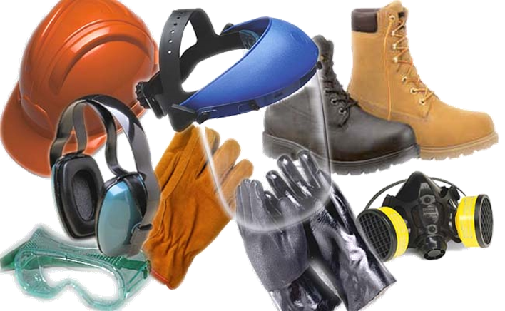
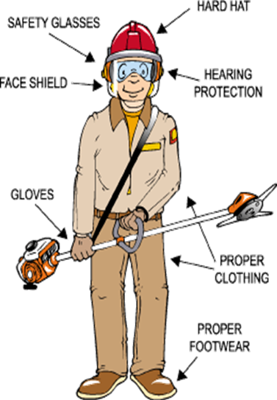
Personal Protective Equipment

Slide 2
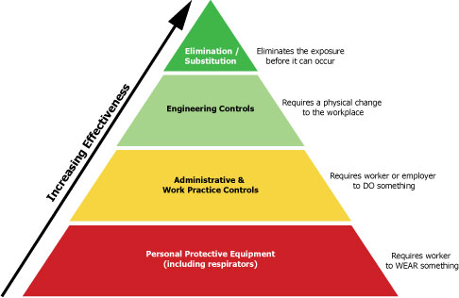
PPE
Personal Protection Equipment (PPE) is required when you work to increase your safety while performing potentially hazardous tasks. PPE may include safety glasses or goggles, dust masks, hard harts, gloves, foot protection, and whole body protection.
PPE is not the first line against protecting employees from hazards
  Elimination
  Engineering Controls
  Administrative / Work Practice Controls
  PPE

Slide 3
Type of Control | Examples
Elimination/Substitution | Substitute with safer alternatives. [See Transitioning to Safer Chemicals: A Toolkit for Employers and Workers]
Engineering Controls (implement physical change to the workplace, which eliminates/reduces the hazard on the job/task) | Change process to minimize contact with hazardous chemicals. Isolate or enclose the process. Use of wet methods to reduce generation of dusts or other particulates. General dilution ventilation. Use fume hoods.
Administrative and Work Practice Controls (establish efficient processes or procedures) | Rotate job assignments. Adjust work schedules so that workers are not overexposed to a hazardous chemical.
Personal Protective Equipment (use protection to reduce exposure to risk factors) | Use chemical protective clothing. Wear respiratory protection. [See the Respiratory Protection Safety and Health Topics page] Use gloves. Wear eye protection.

Slide 4
Hazard Assessment and Equipment Selection
The employer shall assess the workplace to determine if hazards are present, or are likely to be present, which necessitate the use of PPE. If such hazards are present, or likely to be present, the employer shall:
  Select the types of PPE that will protect the affected employee;
  Communicate the selected items with employees; and
  Select PPE that properly fits each affected employee
The employee is responsible for:
  Making the employer aware of their needs/concerns
  Using and maintaining PPE properly

Slide 5
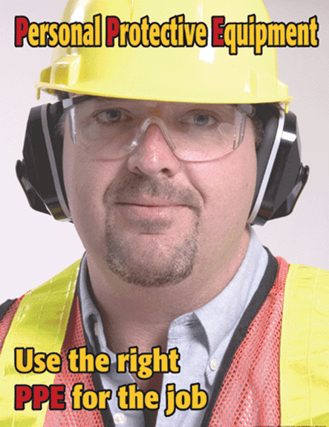
PPE Training
If employees are required to use PPE, then they must be trained in the following:
  When PPE is necessary;
  What PPE is necessary;
  How to properly don, doff, adjust, and wear PPE;
  The limitations of the PPE; and
  The proper care, maintenance, useful life and disposal of the PPE

Slide 6
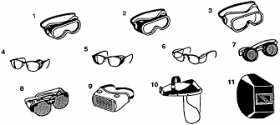
PPE: Eye and Face Protection
When should they be worn?
  When exposed to flying particles, molten metal, liquid chemicals, acids or caustic liquids, chemical gases or vapors, or light radiation (i.e. welding)
When are side shields needed?
  When there is a hazard or potential hazard from flying objects
What about prescription safety glasses?
  While engaged in operations that involve eye hazards
https://www.osha.gov/SLTC/etools/eyeandface/faqs.html#face_shields
Notes:
Q: Can face shields protect employees instead of safety goggles or spectacles?
A: Face shields alone do not protect employees from impact hazards. Face shields may be used in combination with safety goggles or spectacles to protect against impact.

Slide 7
PPE: Respiratory Protection
Respirators protect workers against insufficient oxygen environments, harmful dusts, fogs, smokes, mists, gases, vapors, and sprays.
Respirators protect the user in two basic ways:
  The first is by the removal of contaminants from the air. Respirators of this type include particulate respirators, which filter out airborne particles, and air-purifying respirators with cartridges/canisters which filter out chemicals and gases.
  Other respirators protect by supplying clean respirable air from another source. Respirators that fall into this category include airline respirators, which use compressed air from a remote source, and self-contained breathing apparatus (SCBA), which include their own air supply.

Slide 8
PPE: Respiratory Protection Continued…
How do respirators work?
  Respirators work by either filtering particles from the air, chemically cleaning (purifying) the air, or supplying clean air from an outside source.
Particulate Respirators: Particulate respirators are the simplest, least expensive, and least protective of the respirator types available. These respirators only protect against particles (e.g., dust). They do not protect against chemicals, gases, or vapors, and are intended only for low hazard levels. The commonly known "N-95" filtering facepiece respirator or "dust mask" is one type of particulate respirator, often used in hospitals to protect against infectious agents. Particulate respirators are "airpurifying respirators" because they clean particles out of the air as you breathe.
  Particulate respirators:
    Filter out dusts, fumes and mists.
    Are usually disposable dust masks or respirators with disposable filters.
    Must be replaced when they become discolored, damaged, or clogged.
    Examples: filtering facepiece or elastomeric respirator.

Slide 9
PPE: Respiratory Protection Continued…
Chemical Cartridge/Gas Mask Respirator: Gas masks are also known as "air-purifying respirators" because they filter or clean chemical gases out of the air as you breathe. This respirator includes a facepiece or mask, and a cartridge or canister. Straps secure the facepiece to the head. The cartridge may also have a filter to remove particles.
Gas masks are effective only if used with the correct cartridge or filter (these terms are often used interchangeably) for a particular biological or chemical substance. Selecting the proper filter can be a complicated process. There are cartridges available that protect against more than one hazard, but there is no "all-inone" cartridge that protects against all substances. It is important to know what hazards you will face in order to be certain you are choosing the right filters/cartridges.
  Chemical Cartridge/Gas Mask respirator:
    Uses replaceable chemical cartridges or canisters to remove the contaminant.
    Are color-coded to help you select the right one.
    May require more than one cartridge to protect against multiple hazards.

Slide 10
PPE: Respiratory Protection Continued…
Powered Air-Purifying Respirator (PAPR): Powered air-purifying respirators use a fan to draw air through the filter to the user. They are easier to breathe through; however, they need a fully charged battery to work properly. They use the same type of filters/cartridges as other air-purifying respirators. It is important to know what the hazard is, and how much of it is in the air, in order to select the proper filters/cartridges.
Self-Contained Breathing Apparatus (SCBA) is the respirator commonly used by firefighters. These use their own air tank to supply clean air, so you don't need to worry about filters. They also protect against higher concentrations of dangerous chemicals. However, they are very heavy (30 pounds or more), and require very special training on how to use and to maintain them. Also, the air tanks typically last an hour or less depending upon their rating and your breathing rate (how hard you are breathing).
  Self-Contained Breathing Apparatus:
    Provide clean air from a portable air tank when the air around you is simply too dangerous to breathe.
    All of these respirators (except for the "dust masks" or filtering face pieces) are available in either half-mask or full-face pieces.

Slide 11
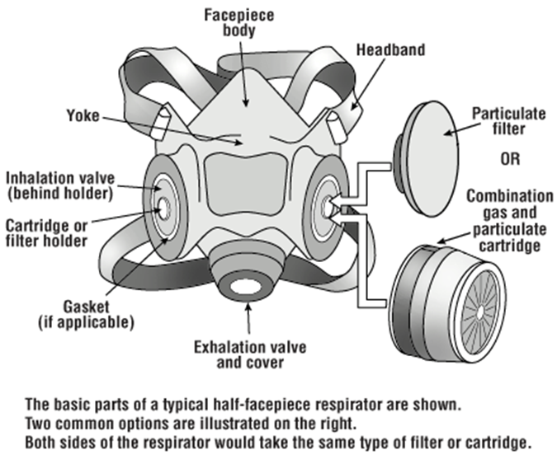
Anatomy of a Respirator

Slide 12
Mandatory vs. Voluntary
Mandatory (training, fit testing, medical clearance)
  Required by the employer (company policy)
  Required by OSHA standard (asbestos/lead abatement)
  To reduce an exposure to below the PEL
Voluntary
  Not required by employer
  When PELs are not exceeded
  Cartridge style respirators – medical clearance still needed
  Appendix D

Slide 13
Appendix D
Respirators are effective only when properly selected and worn.
Improperly used or dirty respirators may be a hazard.
Read and heed all instructions provided by the manufacturer on use, maintenance, cleaning and care, and warnings regarding the respirators limitations.
Choose respirators certified for use to protect against the contaminant of concern. NIOSH, the National Institute for Occupational Safety and Health of the U.S. Department of Health and Human Services, certifies respirators. A label or statement of certification should appear on the respirator or respirator packaging. It will tell you what the respirator is designed for and how much it will protect you.
Do not wear your respirator into atmospheres containing contaminants for which your respirator is not designed to protect against. For example, a respirator designed to filter dust particles will not protect you against gases, vapors, or very small solid particles of fumes or smoke.
Keep track of your respirator so that you do not mistakenly use someone else's respirator.

Slide 14
Respiratory Protection
The first priority is always to reduce exposures by controlling the source, not wearing a respirator.
If you think that your job exposes you to an inhalation hazard, that exposure can be measured by EHS.
Requests for exposure monitoring, or questions about respirators should be directed to Ken Mixon @ EHS.

Slide 15
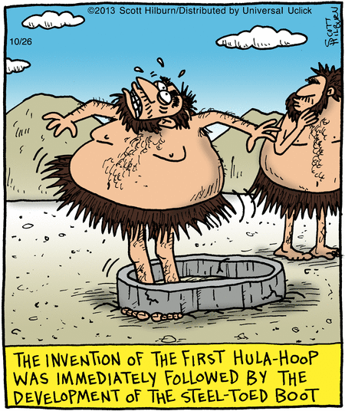
PPE: Head and Foot Protection
Head Protection
  Shall be worn while working in areas where there is a potential for injury to the head from falling objects
Foot Protection
  Shall be worn while working in areas where there is a danger of foot injuries due to falling or rolling objects, or objects piercing the sole, or when the use of protective footwear will protect the employee from an electrical hazard

Slide 16
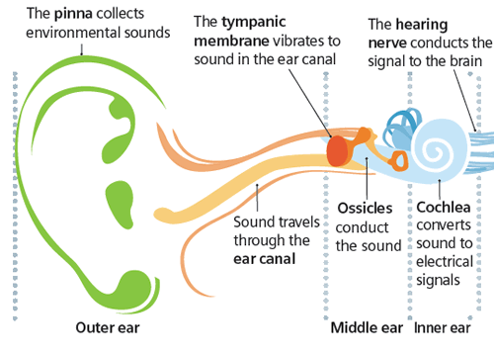
PPE: Hearing Protection
How does the ear work?
  When sound waves enter the outer ear, the vibrations impact the ear drum and are transmitted to the middle and inner ear. In the middle ear three small bones called the malleus (or hammer), the incus (or anvil), and the stapes (or stirrup) amplify and transmit the vibrations generated by the sound to the inner ear. The inner ear contains a snail-like structure called the cochlea which is filled with fluid and lined with cells with very fine hairs. These microscopic hairs move with the vibrations and convert the sound waves into nerve impulses–the result is the sound we hear.
  Exposure to loud noise can destroy these hair cells and cause hearing loss!

Slide 17
What is Noise?
Noise and vibration are both fluctuations in the pressure of air (or other media) which affect the human body. Vibrations that are detected by the human ear are classified as sound. We use the term 'noise' to indicate unwanted sound.
Noise and vibration can harm workers when they occur at high levels, or continue for a long time.

Slide 18
What are the warning signs that your job may be too noisy?
Noise may be a problem in your workplace if:
You hear ringing or humming in your ears when you leave work.
You have to shout to be heard by a coworker an arm's length away.
You experience temporary hearing loss when leaving work.

Slide 19
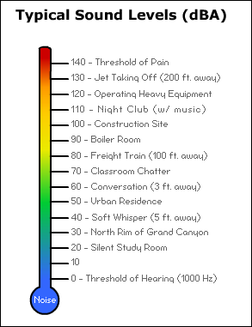
How loud is too loud?
OSHA sets legal limits on noise exposure in the workplace. These limits are based on a worker's time weighted average over an 8 hour day. With noise, OSHA's permissible exposure limit (PEL) is 90 dBA for all workers for an 8 hour day.
The effect of noise on human hearing is dependent upon:
  Noise intensity (how loud)
  Frequency of noise (pitch)
  Duration of exposure (how long)
Notes:
Noise is measured in units of sound pressure levels called decibels, named after Alexander Graham Bell, using A-weighted sound levels (dBA). The A-weighted sound levels closely match the perception of loudness by the human ear. Decibels are measured on a logarithmic scale which means that a small change in the number of decibels results in a huge change in the amount of noise and the potential damage to a person's hearing.
OSHA sets legal limits on noise exposure in the workplace. These limits are based on a worker's time weighted average over an 8 hour day. With noise, OSHA's permissible exposure limit (PEL) is 90 dBA for all workers for an 8 hour day. The OSHA standard uses a 5 dBA exchange rate. This means that when the noise level is increased by 5 dBA, the amount of time a person can be exposed to a certain noise level to receive the same dose is cut in half.
The National Institute for Occupational Safety and Health (NIOSH) has recommended that all worker exposures to noise should be controlled below a level equivalent to 85 dBA for eight hours to minimize occupational noise induced hearing loss. NIOSH has found that significant noise-induced hearing loss occurs at the exposure levels equivalent to the OSHA PEL based on updated information obtained from literature reviews. NIOSH also recommends a 3 dBA exchange rate so that every increase by 3 dBA doubles the amount of the noise and halves the recommended amount of exposure time.
Here's an example: OSHA allows 8 hours of exposure to 90 dBA but only 2 hours of exposure to 100 dBA sound levels. NIOSH would recommend limiting the 8 hour exposure to less than 85 dBA. At 100 dBA, NIOSH recommends less than 15 minutes of exposure per day.
In 1981, OSHA implemented new requirements to protect all workers in general industry (e.g. the manufacturing and the service sectors) for employers to implement a Hearing Conservation Program where workers are exposed to a time weighted average noise level of 85 dBA or higher over an 8 hour work shift. Hearing Conservation Programs require employers to measure noise levels, provide free annual hearing exams and free hearing protection, provide training, and conduct evaluations of the adequacy of the hearing protectors in use unless changes to tools, equipment and schedules are made so that they are less noisy and worker exposure to noise is less than the 85 dBA.

Slide 20
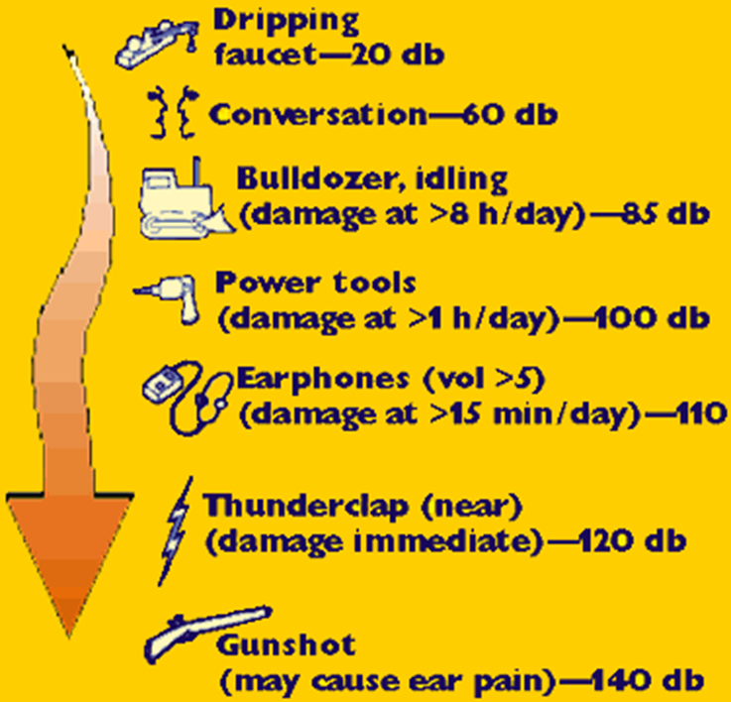
Common sounds may be louder than you think:

Slide 21
Types of Hearing Loss
Temporary
  After exposure to high noise level
  Normal hearing restored after about 16 hours
Permanent
  Occurs after a period of time
  Occurs when temporary losses are not allowed to recover between exposures

Slide 22
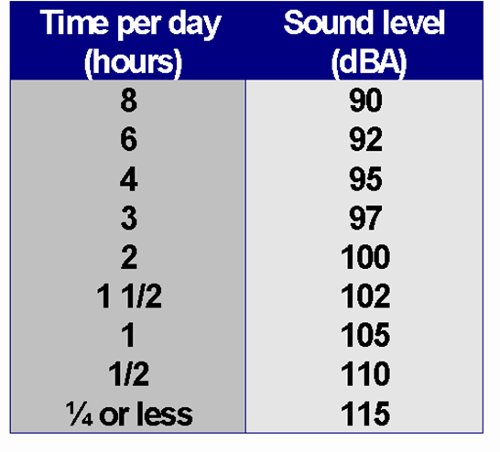
Selection of Hearing Protection
Hearing Protection can:
  Provides barrier between noise source and hearing organs
  Significantly reduces the risk of hearing loss due to excessive noise exposure
  REQUIRED when daily noise exposure exceeds 90 decibels, averaged over 8 hours
Hearing protection devices are selected according to:
  Employee comfort
  Level of noise exposure
  NRR of device
  Type of work being performed
  Environmental conditions
Notes:
NRR – Noise Reduction Rating
The purpose of the NRR is to give an indication of the amount of noise reduction that may be expected with a specific hearing protection device.
This number is to be used as a general guide only! The true amount of noise reduction depends on how the employee inserts the hearing protector into the ear.

Slide 23
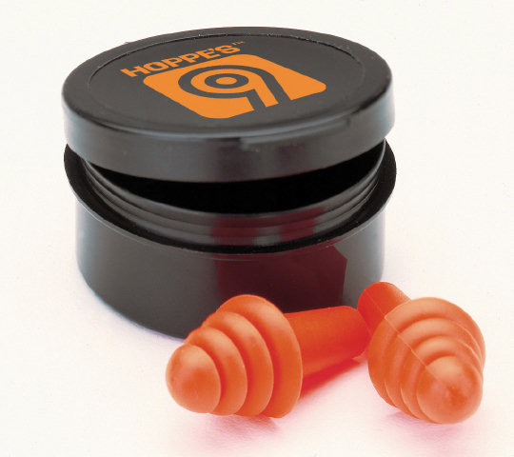
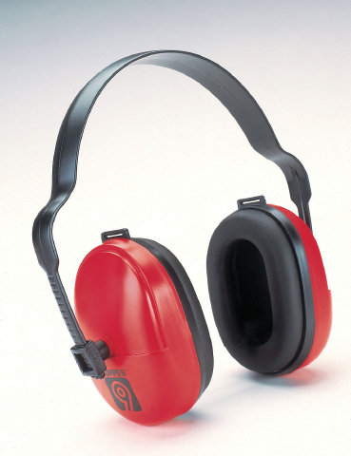
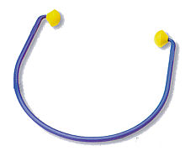

Types of Hearing Protection
Ear muffs
Foam insert earplugs
Semi-aural earplugs
Head Phones are Not Hearing Protection

Slide 24
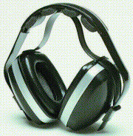
Ear Muffs
Advantages
More protection at higher frequencies than earplugs
Various NRRs available
Durable, long lasting
Can be fitted on hard hat
Reusable
Disadvantages
Higher cost
Eye glasses can interfere with ear muff seal
May be uncomfortable in hot environments
Must be cleaned before use by another worker
Notes:
When wearing ear muffs:
Remember that anything that comes between your ear and the ear muff will make them less effective and reduce your level of protection! Also, you should choose eyewear with thin temples so they don't interfere with the seal. Some ear muffs attach to hard hats to form a good seal when wearing a hard hat.
Also, when putting on ear muffs, remember to push your hair away from your ears. Center the ear muffs over your head and make sure the seal is tight. Adjust the headband so the ear muffs are resting comfortably on your head. The cups should entirely cover your ears.
Before you put on your earmuffs, it is important to inspect them for cracks, tears or other signs of wear.

Slide 25
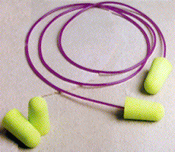
Foam Insert Earplugs
Advantages
More protection at lower frequencies than muffs
Various NRRs available
Inexpensive; disposable
Can be custom molded for individual worker
Reusable plugs are available
Disadvantages
Hands must be cleaned before inserting earplugs
Improper insertion reduces NRR value
Notes:
DEMONSTRATE PROPER INSERTION/USE OF EAR PLUGS AND MUFFS
When inserting your ear plugs:
Before putting ear plugs in, wash your hands to prevent infections from entering the ear.
Inspect the ear plugs for tears, cracks or hardening.
To insert a malleable foam plug, roll the blug between your fingers and thumb to make it thinner, making sure there are no wrinkles or creases in the plug.
Reach one hand behind your head and pull your ear outward and upward to widen the auditory canal. Insert the plug well into the ear and hold it in place until it expands. Don't be afraid to place the plug into the ear canal. You cannot hurt your eardrum because the plugs are too short to reach it. If the seal is not tight, the earplug will not be effective.
Remember to properly clean and store your ear plugs!

Slide 26
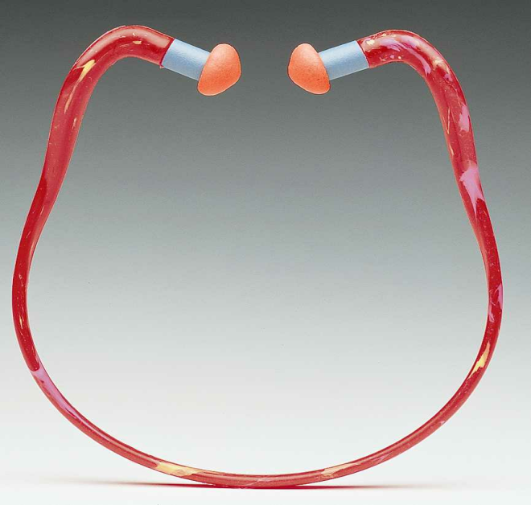
Semi-aural Caps
Advantages
Various NRRs available
Easy to insert
May be used several times
Ideal for people going in and out of noisy areas
Disadvantages
Improper insertion reduces effectiveness
More expensive than ear plugs
Typically have lower NRRs than plugs or muffs

Slide 27
Audiometric Testing
Monitors employee’s hearing over time
Baseline audiogram must be performed within first 6 months of work exposure ( 8 hour TWA ≥ 85 dBA)
Annual audiograms are required each year after baseline audiogram
Employer must pay for the cost of each required audiogram

Slide 28
Why Do Audiometric Testing?
Obtain a Baseline Audiogram for future comparison
Identify occupational hearing loss
Identify Standard Threshold Shifts (STS)
Notes:
Standard Threshold Shift – a change in hearing threshold relative to the baseline audiogram of an average of 10 dB or more.

Slide 29
Hearing Conservation Training
The effects of noise exposure on hearing
The purpose of your department’s Hearing Conservation Program
The proper selection and use of hearing protection devices
The purpose of audiometric testing
Who is subject to audiometric testing
New employees test within 6 months of hire

